Slide 1
The Cloud

Slide 2
Why the cloud?
Rapidly setup environments to drive business priorities
Scale to meet peak demands
Increase daily activities, efficiency and reduced cost.
Speed
Scale
Economics

Slide 3
Pay only for what you use
Notes:
Speaking Points:
The final thing I’ll mention about Windows Azure, before we dive into the tour of services is the approach we’re taking with paying for services.
This maybe different for many of you who are familiar with hosting providers and on-premises systems.
With Windows Azure you pay only for what you use.
There are no upfront cost
There is no need to buy any up front server licenses, that’s just included in the price
Likewise if you use a SQL database, through our SQL Database feature in Windows Azure, you don’t have to buy a SQL Server license, that’s also included in the price.
For compute services such as Virtual Machines and Web Sites you only pay by the hour.
This gives you the flexibility to run your applications very cost effectively.
You can scale up and scale down your solutions or even turn them on and off as necessary.
This also opens up a ton of possibilities in terms of the new types of apps you can build

Slide 4
Hosting Models
Business model
On Premises
Infrastructure
(as a Service)
Platform
(as a Service)
Software
(as a Service)
Applications
Applications
You manage
Applications
Applications
You scale, make resilient and manage
You scale, make
resilient & manage
Data
Data
Data
Data
Runtime
Runtime
Runtime
Runtime
Scale, resilience and management by vendor
Middleware
Middleware
Middleware
Scale, resilience and management by vendor
Middleware
O/S
O/S
O/S
O/S
Virtualization
Virtualization
Managed by vendor
Virtualization
Virtualization
Servers
Servers
Servers
Servers
Storage
Storage
Storage
Storage
Networking
Networking
Networking
Networking

Slide 5
Azure

Slide 6
Offline Operations
Remote Debug
Tag Expressions
Traffic Manager
Site to Site Virtual Network
Stop without Billing
Xamarin integration
Large Memory SKU
Hyper-V Recovery
SQL, SharePoint, BizTalk Images
HDInsight
Cloud Services SDK 2.0
Mercurial Deployment
Scheduler
Windows Phone Support
Distributed Cache
Partitioned Queues/Topics
AutoScale
Per Minute Billing
Dynamic Remote Desktop
Log Streaming
Android Support
IaaS
HTML 5/CORS
Active Directory
Custom Mobile API
IP and SNI SSL
Last 12
http Logs to Storage
BizTalk Services
IP/DDOS Protection
Hyper-V Disaster Recovery Support
Multi-Factor Auth
MSDN Dev/Test Integration
months
http Logs to Storage
Dynamic Remote Desktop
Storage Analytics
WebSockets
Delete Disks
AMQP Support
iOS Notification Support
VIP ACLs
New VM Gallery
PowerBI
Read-Only Secondary Storage
Queue Geo Replication
Mobile Services
Windows Server Backup
New Relic
Notification Hubs
Manage Azure in AD
Git Source Control
AD Directory Sync
Windows 8 Notification Support
AD Management Portal
CORS/JSON Storage Support
B2B/EDI and EAI Adapters
Point to Site
Software VPN
VOD Streaming + Encoding
Web Sites
Media Services
AutoScale/Monitoring
VS Online
Message Pump Programming Model
Import/Export Hard Drives

Slide 7

19 regions worldwide in 2014
Azure footprint

Slide 8

>100 MILLION
Viewers
>2.1 MILLION
Concurrent HD viewers during the USA vs. Canada hockey match

Slide 9


















Support for Open Source
Languages
CMS
Devices
Databases / Apps
Operating
systems
Management

Slide 10






Microsoft Azure Services
Office Add-in
PC
Tablet
Phone
Browser
Games console
On-premises service
On-premises database
Client layer
(on-premises)
Access Control
Layer
AD
Multifactor
Authentication
BizTalk Services
Service Bus
CDN
Traffic Manager
Virtual Networks
Express Route
Integration
layer
API Mgmt
Mobile Services
Websites
Cloud Services
VM
Media Services
Notification Hubs
Scheduler
Automation
Application
layer
Blobs
Tables
Queues
SQL Database
Machine Learning
HD Insight
Caching
Backup and Recovery
StorSimple
Data Layer
Storage
Data

Slide 11



Microsoft Azure Web Sites
Start simple
Code smart
Go live
Create new sites in seconds
Easily manage and scale your sites
Automatic load balancing and shared storage across instances
Scale out or up to reserved instances for improved performance and scale
Built-in web jobs support
Use ASP.NET, ASP, PHP, Java or Node.js
SQL Azure or MySQL databases
Start with open source apps and frameworks
Develop with VS and WebMatrix
Supports any Web development tool on any platform (Windows, OSX, Linux)
Rapid deployment for quick iteration
Integrated source control with Team Foundation Server (TFS) and Git
Built-in monitoring of perf and usage data
Quick access to request logs, failed requests diagnostics and diagnostics
Office Blog ASP.NET microsoft.com

Slide 12
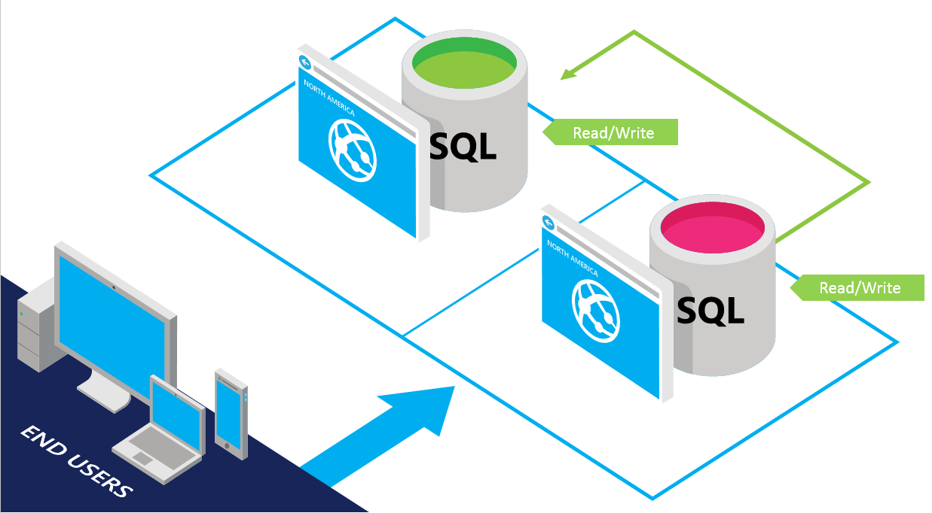
SQL Database
DB
SQL Server database technology as a service
Fully Managed
Enterprise-ready with automatic support for HA
Designed to scale out elastically with demand
Ideal for simple and complex applications
Full support for TDS and ODBC
Familiar language and framework support
Cross Datacenter failover and backups to support disaster recovery scenarios

Slide 13







Mobile Services
Provides essential services to support client development
Client Support
iOS
Android
HTML5/Web
Xamarin
Windows
Windows Phone
PhoneGap
Sencha
Storage
Authentication
Logic
Push
Scheduler
Notes:
Speaking Notes
Azure Mobile Services is a Backend-as-a-Service
Instead of you having to design, build, test, deploy, manage, and upgrade your whole backend, we do it for you
Features of Mobile Services
Storage – SQL DB
Authentication – built in support for social providers w/ ability to custom auth
Backend logic – data validation, logical flows, etc
Push Notifications – across all major mobile platforms
Scheduler – backend job processing

Slide 14
Virtual Machines
Getting started
Select image and VM size
New disk persisted in storage
Management portal
Windows Server
Boot VM from new disk
>_
Linux
Scripting
(Windows, Linux and Mac)
Blob Storage
Extra Small
Small
Medium
Large
X-Large
REST API
Cloud
Comprehensive
Networking

Slide 15
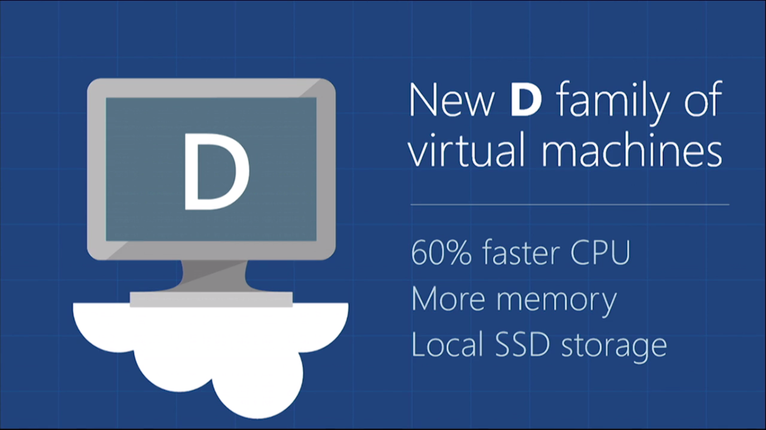

Slide 16

Announcing the G family
Largest Virtual Machines in the public cloud
G
Optimized for data workloads
Up to 32 CPU cores, 450 GB RAM, 6.5 TB local SSD
Latest generation Intel processor
Notes:
2x memory aws , 4x memory of google

Slide 17
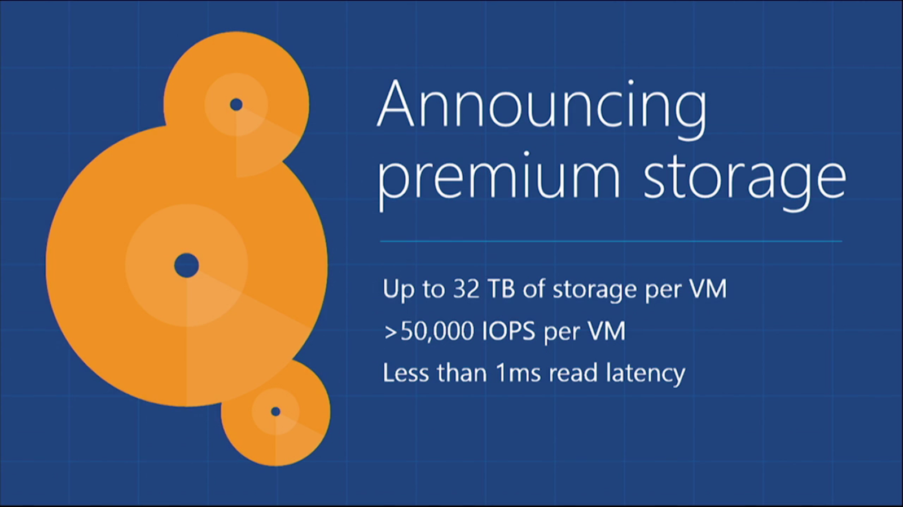

Slide 18

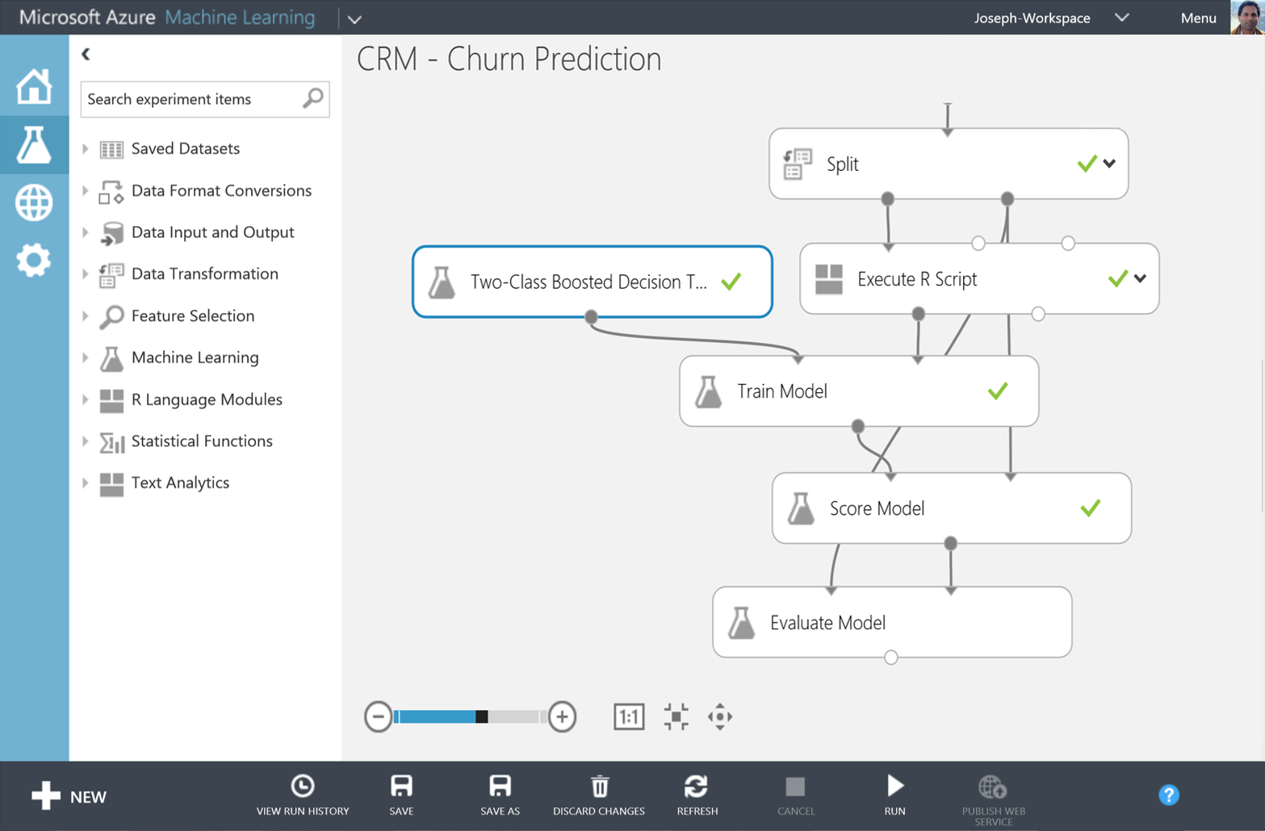
Big Data Insights
Microsoft Azure HDInsight
Microsoft Azure Machine Learning
Microsoft instance of Hadoop distribution running as service
Support existing ecosystem from Hive, Pig, etc
Extended to support Excel and BI tooling
Integration with diverse sources of data
Mashup sophisticated intelligent algorithms
Enables data scientists and developers to efficiently embed predictive analytics into their applications
Elastic, pay as you go with low operating costs
Extend with Power BI, Hadoop and cloud hosted data

Slide 19

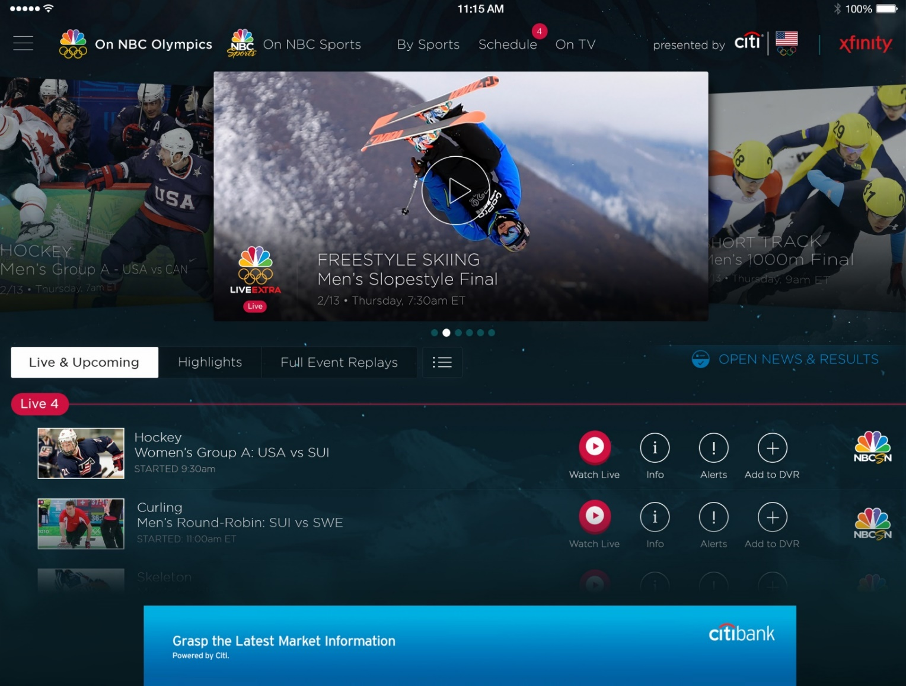
Azure Media Services
Olympics NBC Sports
On Demand Media Services
Video-on-demand
Ingest
Encode
Package
Encrypt
Delivery
Live Streaming Support
Office 365 Integration
Live video encoding and streaming
Web + Mobile
100 million viewers
2.1 million concurrent HD viewers during the USA vs. Canada hockey match

Slide 20















Application building blocks
Virtual Machines
Web Sites
Cloud Services
Mobile
Traffic
Caching
Messaging
Identity
CDN
Media
Networking
Database
BizTalk Svcs
Storage
Big data
Notes:
Speaking Points:
In addition to the compute services for running your deploying and running your code, Windows Azure also provides a number of application building blocks.
These are managed services that we run that provide a lot of value so you can avoid standing up the infrastructure for common capabilities
You always can stand up VMs and put anything you want in it
But in a lot of cases you will find that we have built in services that we deliver or that are delivered by our partners
What’s cool is that you can use any of these services with a VM, with a Web Site, or with a Cloud Service – so you have flexibility in how you will consume them.

Slide 21
Demo: Azure Portal

